Slide 1
FINAL PROJECT
SKIN CANCER DETECTION
KOUSHIKA PURNA VELAMATI
PSG Institute of Technology and Applied Research
B.E. Computer Science and Engineering
NM id: au715521104024
Email: koushikapv@gmail.com
3/21/2024 Annual Review

Slide 2
PROJECT TITLE
Title: Skin Cancer detection system
Description : The project focuses on leveraging deep learning techniques for skin cancer detection, aiming to detect skin cancer By leveraging neural networks trained on parameters extracted from a CSV file containing relevant features of skin lesions, this project aims to develop an automated system capable of efficiently and accurately detecting potential cases of skin cancer. The goal is to create a robust tool that can assist medical professionals in early diagnosis and intervention, ultimately improving patient outcomes and saving lives.
3/21/2024 Annual Review

Slide 3


AGENDA
Problem Statement
Project overview
End Users
Proposed solution
Algorithm & Deployment
Modelling
Result
3/21/2024 Annual Review

Slide 4

PROBLEM STATEMENT
Develop a neural network-based skin cancer detection system utilizing features extracted from a CSV file containing parameters of skin lesions, aiming to automate and enhance the accuracy of diagnosis.
Address the challenge of subjective and time-consuming visual inspection methods for identifying malignant and benign skin lesions by leveraging machine learning techniques to analyze structured data representing key features of skin lesions.
Create a robust and efficient tool capable of accurately classifying skin lesions as either malignant or benign, with the ultimate goal of improving early detection rates and assisting medical professionals in timely intervention to mitigate the risks associated with skin cancer.
3/21/2024 Annual Review

Slide 5

PROJECT OVERVIEW
Develop an automated skin cancer detection system using neural networks trained on CSV data, aiming for accurate classification of lesions as benign or malignant.
Train neural networks on structured lesion data to recognize patterns indicative of cancer, enabling automated diagnosis.
Improve early detection rates and aid medical professionals in timely intervention, potentially saving lives by reducing the morbidity and mortality of skin cancer.
3/21/2024 Annual Review

Slide 6

WHO ARE THE END USERS?
Patients: Patients concerned about potential skin cancer could benefit from the system by receiving timely and accurate assessments of their skin lesions, leading to prompt medical attention and treatment if necessary.
Dermatologists and Medical Professionals: Dermatologists and other healthcare professionals who specialize in skin care would use the system as a diagnostic tool to aid in the evaluation of skin lesions and provide accurate diagnoses.
General Practitioners: General practitioners in primary care settings could utilize the system to assist in the initial assessment of suspicious skin lesions and determine whether further evaluation or referral to a specialist is necessary.
Medical Researchers: Researchers studying skin cancer detection and treatment methods may use the system for data analysis and to evaluate the performance of new algorithms or diagnostic techniques.
3/21/2024 Annual Review

Slide 7

YOUR SOLUTION AND ITS VALUE PROPOSITION
A deep learning-based skin cancer detection system that accurately identifies diseases using data processing techniques and machine learning algorithms.
Accuracy: Our skin cancer detection solution boasts industry-leading accuracy, ensuring reliable and precise identification of skin lesions with exceptional performance.
Efficiency: Automates detection, saving time over manual methods.
Scalability: Handles large datasets and detects effectively.
Innovation: Our skin cancer detection solution represents a groundbreaking innovation in leveraging advanced neural network architecture and transfer learning for highly accurate and efficient diagnosis.
3/21/2024 Annual Review

Slide 8

THE WOW IN YOUR SOLUTION
Our solution significantly enhances the efficiency of skin cancer detection, enabling early diagnosis and intervention. By accurately identifying a diverse range of skin lesions, it empowers healthcare professionals to provide timely and targeted treatments, ultimately improving patient outcomes and reducing the burden on healthcare systems.With its remarkable accuracy and efficiency, our solution has the potential to transform skin cancer diagnosis and management practices. By streamlining the diagnostic process and providing actionable insights, it revolutionizes the way skin cancer is detected, diagnosed, and treated, leading to better healthcare outcomes for patients worldwide.Our solution is designed to be scalable and accessible, making it suitable for deployment across various healthcare settings. Whether in clinics, hospitals, or remote areas with limited access to dermatologists, our solution can be seamlessly integrated into existing workflows, ensuring widespread adoption and impact.
3/21/2024 Annual Review

Slide 9
MODELLING
Identify relevant features from the dataset that are informative for distinguishing between benign and malignant skin lesions. Consider using techniques such as principal component analysis (PCA) or feature selection algorithms to reduce dimensionality and improve model performance.
Develop a training strategy for the neural network, including the selection of loss functions, optimization algorithms, and regularization techniques. Implement techniques such as data augmentation to increase the diversity of the training dataset and improve the generalization ability of the model.
Fine-tune the hyperparameters of the neural network, such as learning rate, batch size, and dropout rate, to optimize model performance. Utilize techniques such as grid search or random search to explore the hyperparameter space efficiently.
3/21/2024 Annual Review

Slide 10
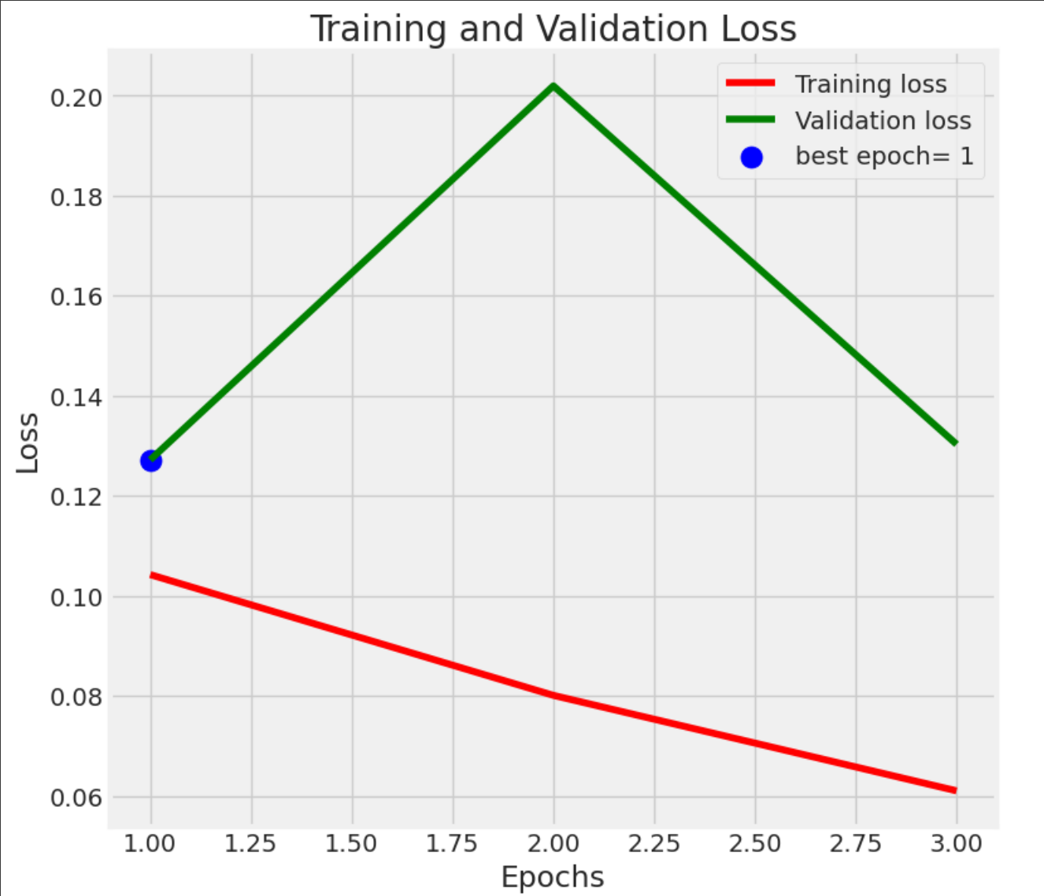
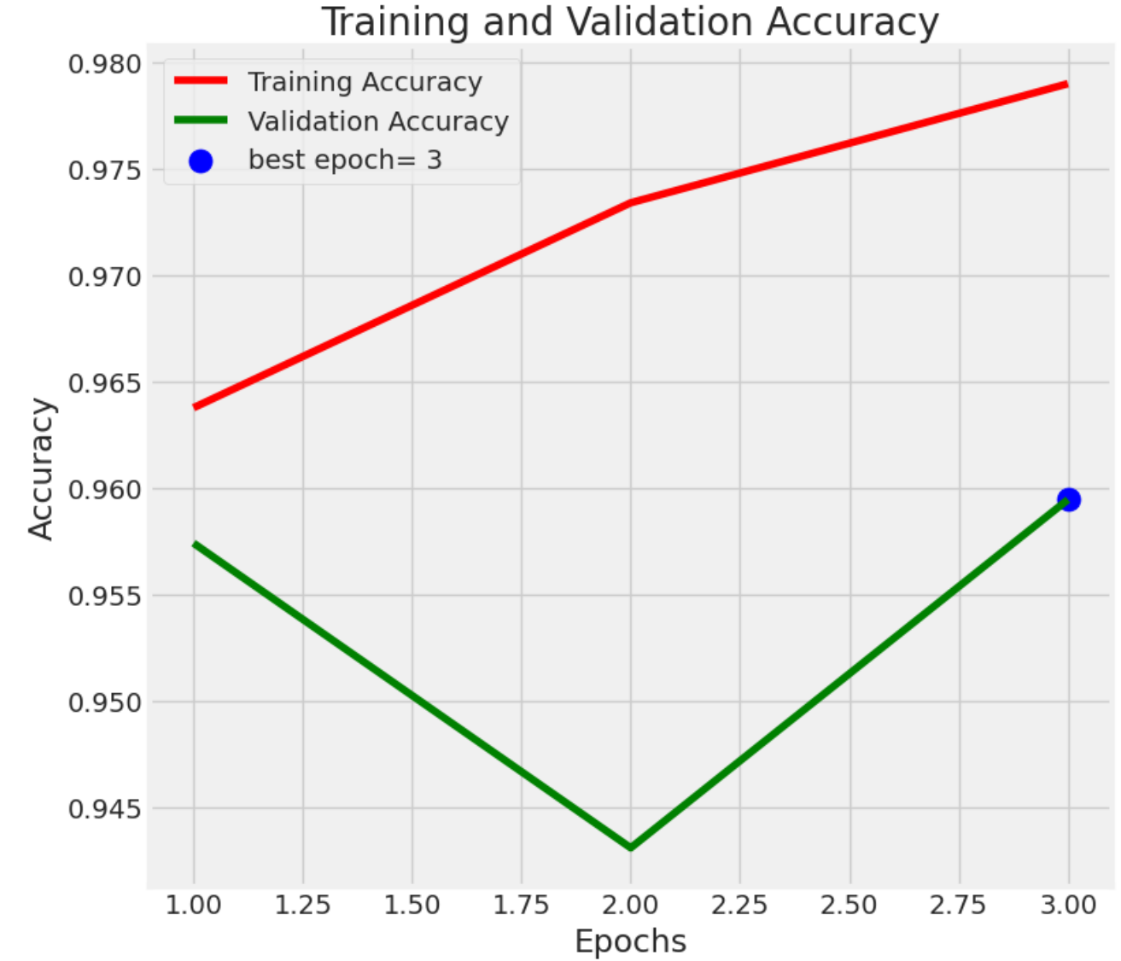
RESULTS
Demo Link
3/21/2024 Annual Review

